Slide 1

Object Oriented Programming with Java(BCS-403) Unit-3

Slide 2
Table of Content
Java Module System
Diamond Syntax with Inner Anonymous Class
Local Variable Type Inference
Switch Expressions
Yield Keyword
Text Blocks
Records
Sealed Classes

Slide 3
Java Module System
originally proposed in 2005 for Java 7.
Java modules, introduced in Java 9, are a game-changing feature that revolutionizes the way developers organize and manage their code.
They promote better code reusability, maintainability, and separation of concerns, empowering you to build scalable and efficient applications.
As our code size increased, packages in java also got increased.
Imagine working on a very large program using hundreds of packages, in such case it is very difficult to understand which classes is using what. Packages are great way of organizing classes but there needs to be way to organize packages when we need to use several of them in our code.

Slide 4
Java Module System
It’s a “package of Java Packages” abstraction that allows us to make our code even more reusable.
packages inside a module are identical to Java packages.
To create a module, organize the code internally in packages just like we previously did with any other project.
Aside from organizing our code, packages are used to determine what code is publicly accessible outside of module.
Each module is responsible for its resources, like media or configuration files.

Slide 5
What is a module?
Modularity adds a higher level of aggregation above packages. The key new language element is the module—a uniquely named, reusable group of related packages, as well as resources (such as images and XML files) and a module descriptor specifying
-module’s name
-module’s dependencies (other modules this module depends on)
-packages it explicitly makes available to other modules
-services it offers
-services it consumes
-to what other modules it allows reflection

Slide 6
Java Module Types
4 types are:-
System Modules – These are modules listed when we run the list-modules command, include Java SE and JDK modules.
Application Modules – These modules are what we usually want to build when we decide to use Modules. They are named and defined in the compiled module-info.class file included in the assembled JAR.
Automatic Modules – include unofficial modules by adding existing JAR files to the module path. The name of module will be derived from the name of the JAR. Automatic modules will have full read access to every other module loaded by the path.
Unnamed Module – When a class or JAR is loaded onto the classpath, but not the module path, it’s automatically added to the unnamed module. It’s a catch-all module to maintain backward compatibility with previously-written Java code.

Slide 7
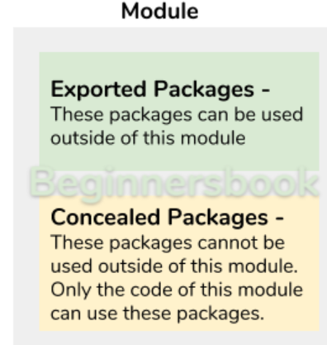
Types of modules
A module is a set of packages. We have two types of packages in a module :-
Exported Packages: These packages are intended to be used outside of the module, which means any program residing in any other module can use these packages.
Concealed Packages: These packages are not intended to be used outside, they are internal to the module and can be used inside the module only.

Slide 8
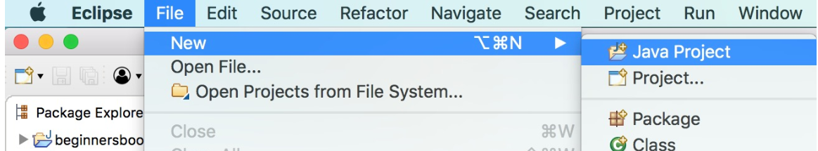
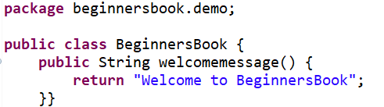
Create and Use module in Eclipse
1. Creating a Java Project
2. Create module-info.java file
3. Create a package and a class
We are creating a class in this module and we will use this class in another module. We are creating a class “BeginnersBook” in the package “beginnersbook.demo“.

Slide 9
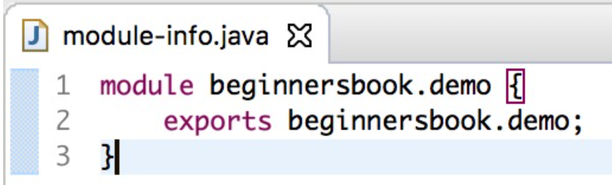
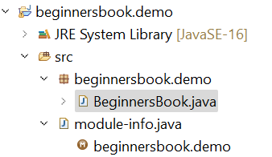
Create and Use module in Eclipse
4. Export the package that we have created
to use the class “BeginnersBook” in another module, lets make this package exported so that it can be used outside of the module. To do this, write this code in module-info.java file –
Final Structure of project beginnersbook.demo looks like this:

Slide 10
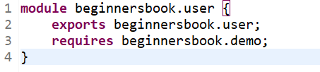
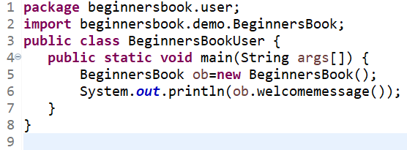
Create and Use module in Eclipse
5. Lets create another module
create a new java project, name it as “beginnersbook.user” and create the module-info.java file the same way that we have created above and name it as “beginnersbook.user”.
6. Lets create a class in second module
Create a class “BeginnersBookUser” in this project under package “beginnersbook.user“.

Slide 11
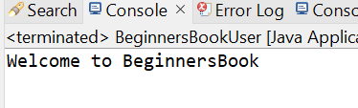
Create and Use module in Eclipse
7. Final Step
run the BeginnersBookUser class, you should get the following output:
To summarize, a class is created in a module and exported the package so that the class can be used outside the module. To test it, we have created another class in a different module and used the exported package and finally used that class that we have created first.

Slide 12
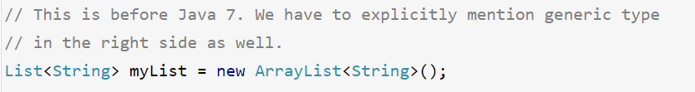
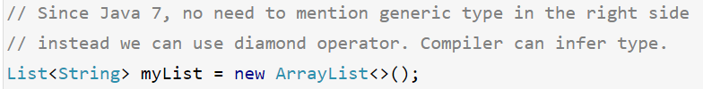
Diamond Syntax( <>)
Diamond syntax, sometimes known as diamond operator, It was added to Java 7 as just a new feature.
Purpose of diamond operator is to avoid redundant code by leaving the generic type in the right side of the expression.
The diamond operator makes it easier to employ generics while building an object. By allowing implicit duplicate parameter type specification

Slide 13
Diamond Syntax with Inner Anonymous Class
Java 9 introduced a new feature that allows us to use diamond operator with anonymous classes.
Using the diamond with anonymous classes was not allowed in Java 7.
In Java 9, as long as the inferred type is denotable, we can use the diamond operator when we create an anonymous inner class.
Data types that can be written in Java program like Integer, String etc are called denotable types.

Slide 14
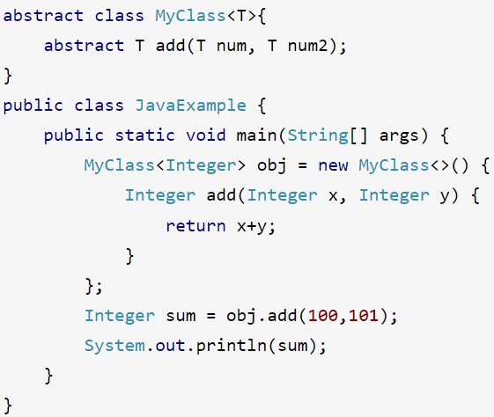
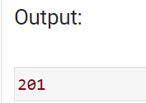
Diamond operator with Inner Anonymous Class
Java 9 improved the use of diamond operator and allows us to use the diamond operator with anonymous inner classes

Slide 15
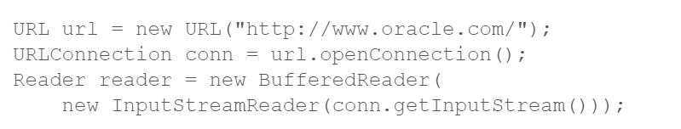
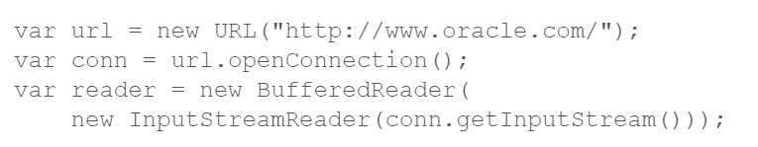
Local Variable Type Inference
In JDK 10 and later, you can declare local variables with non-null initializers with the var identifier, which can help writing code that is easier to read.
Rewriting above code using var type inference----

Slide 16
Local Variable Type Inference
var is reserved type name not a keyword meaning that existing code that used var as a variable , method or package name is not affected.
var can be used for types:-
Local variable declarations with initializers
Enhanced for-loop indexes
Index variables declared in traditional for loops
Try-with-resources variable
Formal parameters declarations of implicitly types lambda expressions

Slide 17


var list = new ArrayList<String>(); // infers ArrayList<String>
var stream = list.stream(); // infers Stream<String>
var path = Paths.get(fileName); // infers Path
var bytes = Files.readAllBytes(path); // infers bytes[]
List<String> myList = Arrays.asList("a", "b", "c");
for (var element : myList) {...} // infers String
for (var counter = 0; counter < 10; counter++) {...} // infers int

Slide 18

try (var input =
new FileInputStream("validation.txt")) {...} // infers FileInputStream
BiFunction<Integer, Integer, Integer> = (a, b) -> a + b;

Slide 19
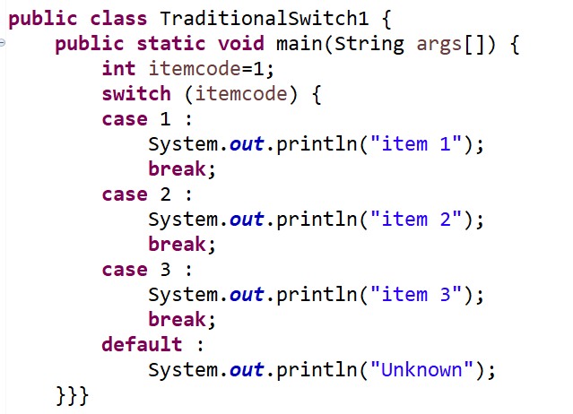
Traditional switch and issues
Default fall through due to missing breaks.
Multiple values per case is not supported
Use of break statement in each case, work as expected.
But in case you miss to include break statement switch fall through.
item 1

Slide 20
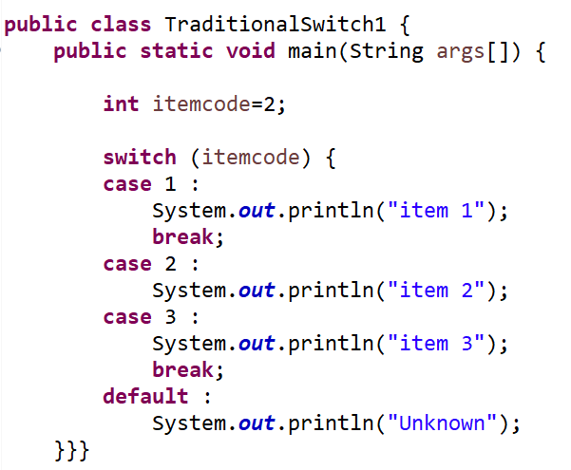
Traditional switch and issues
If you miss to include ‘break’ statement , switch fall through.

Slide 21

Switch Expressions
Java 12 and 13 improved the traditional switch statement and made it more useful.
Like all expressions, this expression evaluate to a single value and can be used in statements
They contain “ case L ->” labels that eliminate the need for break statements to prevent fall through.
Use a yield statement to specify the value of a switch expression
case label_1, label_2, ..., label_n -> expression;|throw-statement;|block

Slide 22
Advantage with switch statement
Support multiple values per case
Switch does not fall through
yield is used to return a value
switch can be used as an expression
Switch with arrow (->) symbol
Variables declared in traditional switch exists until end of the switch statement . If you need variable level scope , use {} introduced in Java 13.

Slide 23
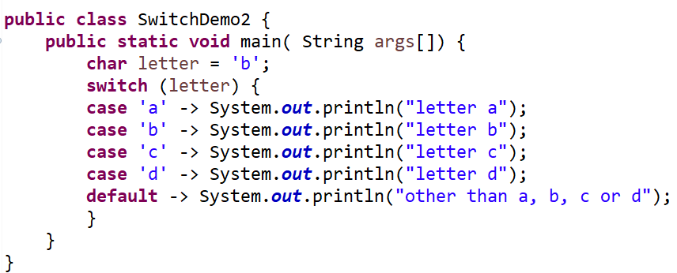
Example Java program 1 ( switch )

Slide 24
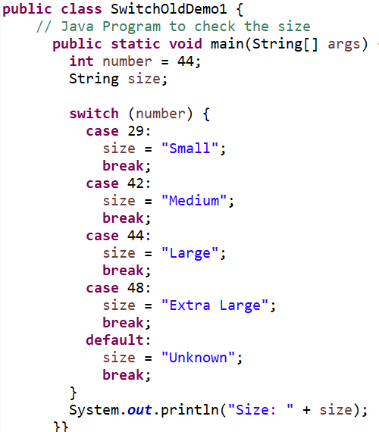
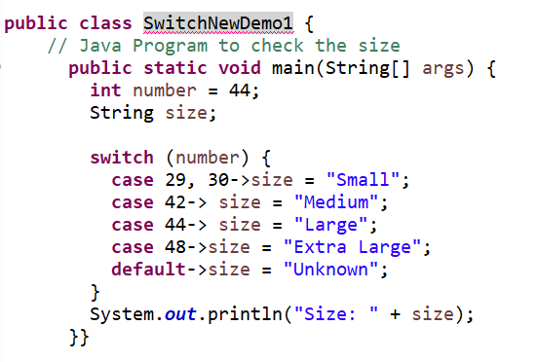
Example Java program (Old vs New)

Slide 25
yield Keyword
The yield keyword lets us exit a switch expression by returning a value that becomes the value of the switch expression.
This means we can assign the value of a switch expression to a variable.
Lastly, by using yield in a switch expression, we get an implicit check that we’re covering our cases, which makes our code more robust.

Slide 26
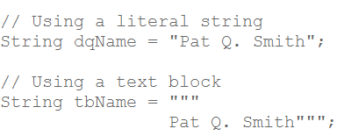
Text Blocks
A text block is an alternative form of Java string representation that can be used anywhere a traditional double quoted string literal can be used.
Text blocks can be used anywhere a string literal can be used.
Text blocks may be used as a method argument

Slide 27
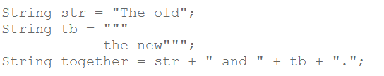
Need for Text Blocks
In earlier releases of the JDK, embedding multi-line code snippets required a tangled mess of explicit line terminators, string concatenations, and delimiters.
Text blocks eliminate most of these obstructions, allowing you to embed code snippets and text sequences more or less as-is.
It provide clarity by way of minimizing the Java syntax required to render a string that spans multiple lines.

Slide 28
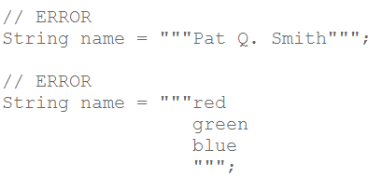
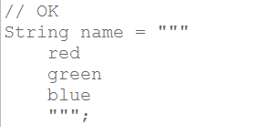
Text Block Syntax
A text block begins with three double-quote characters followed by a line terminator.
You can't put a text block on a single line, nor can the contents of the text block follow the three opening double-quotes without an intervening line terminator.
reason for this is that text blocks are primarily designed to support multi-line strings, and requiring initial line terminator simplifies the indentation handling rules

Slide 29
Records
Records are immutable data classes that require only the type and name of fields.
The record is a new type of class in Java that makes it easy to create immutable data objects.
introduced in Java 14 as an early preview, Java 15 aims to refine a few aspects before becoming an official product feature.
EXAMPLE-
Consider a class Employee, objective is to contain employee’s data like ID and name and act as a data carrier to be transferred across modules.
To create such a simple class, you need to define its constructor, getter, and setter methods, if you want to use object with data structures like HashMap or print the contents of its objects as a string, we would need to override methods such as equals(), hashCode(), and toString().

Slide 30
Properties of Records
You can use nested classes and interfaces inside a record.
You can have nested records too, which will implicitly be static.
A record can implement interfaces.
You can create a generic record class.
It is possible to use local record classes (since Java SE 15).
Records are serializable.
Record objects have an implicit sensible implementation of hashCode(), equals(), and toString() methods.
With Java 15, native methods cannot be declared in records.
With Java 15, implicit fields of record are not final and modification using reflection will throw IllegalAccessException.

Slide 31
Purpose/Advantages of Records
purpose of a record is to create a data object or a POJO(Plain Old java Objects) which is used to carry data in application program flow.
In a multi-tier program, Domain/Model objects store the data captured from the data source and then these model objects are passed further to the application/UI layer to process the data and vice versa where UI/Application stores data in data objects and then pass these objects to Data layer to populate data sources.
As these data objects contain a lot of fields, developers are required to write a lot of setter/getter methods, parameterized constructors, overridden equals methods, and hashcode methods.
In such a scenario, record comes to the rescue as it provides most of the boilerplate code and the developer can focus on required functionalities only.

Slide 32

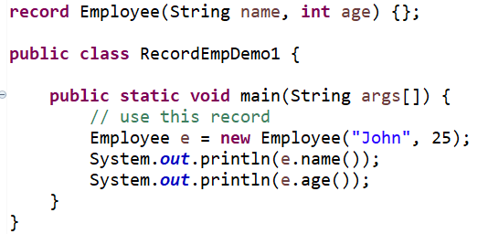
Declaring and Using Java Record
To declare a record, use the record keyword, followed by the record name and the state description enclosed in parenthesis.
To use this record, you can create a new instance of Employee

Slide 33
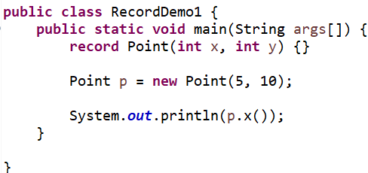
Example code record

Slide 34
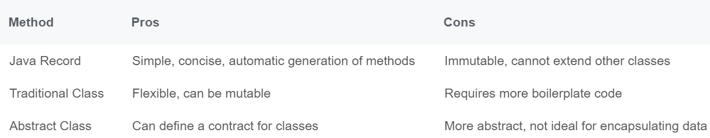
Record Vs Traditional classes vs Abstract classes

Slide 35
Sealed Classes
In programming, security and control flow are the two major concerns that must be considered while developing an application.
There are various controlling features such as the use of final and protected keyword restricts the user to access variables and methods.
Java 15 introduces a new preview feature that allows us to control the inheritance i.e. the concept of sealed classes.
Java sealed classes and interfaces restrict that which classes and interfaces may extend or implement them.
In other words, we can say that the class that cannot be inherited but can be instantiated is known as the sealed class. It allows classes and interfaces to have more control over their permitted subtypes.
It is useful both for general domain modeling and for building a more secure platform for libraries.

Slide 36
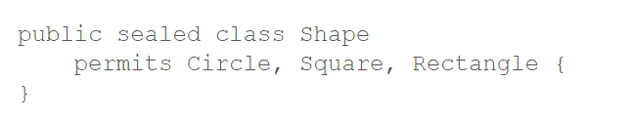
Declaring Sealed Classes
To seal a class, add sealed modifier to its declaration.
Then, after any extends and implements clauses ,add the permits clause.
This clause specifies the classes that may extend the sealed class.
Example-
Shape specifies three permitted subclasses , Circle, Square, Rectangle

Slide 37
Constraints on Permitted Subclass
All the permitted subclasses must belong to the same module or package as the sealed class.
Every permitted subclass must explicitly extend the sealed class.
Every permitted subclass must define a modifier: final, sealed, or non-sealed.

